Slide 1
COMPOSITE MATERIALS – NEW AGE OF THE USAGE
Klavdija Stropnik, prof.
4. oktorber 2017

Slide 2
START OF TRAINING

Slide 3
Invited the companies and their employees to project
Companies who were participated:
SAVATECH d. o. o.
ISKRA d. d.
AMT PROJEKT d. o. o.
TRIVAL KOMPOZITI
LPKF Laser & Electronics d.o.o.
KOMUNALA TRŽIČ

Slide 4
PRESENTATION COMPOSITE MATERIALS FOR THE EMPLOYEES AND STUDENTS

Slide 5
Date of presentation:
Employees | Students
3. 4. 2017 – 19. 4. 2017 | 12. 5. 2017 – 27. 9. 2017
Numbers of employees | Numbers of students
9 | 10

Slide 6
Employees and students were intruducing with composite materials from metal working and chemistry.
In the laboratory: was intruducing with structure of materials and how to made the composites.
Extra material (literature) for practice working

Slide 7
Picture 1: work in laboratory

Slide 8
PROBLEMS THROUGH THE TRAINING
In the literature we missed the chemistry explanation of composites (chemistry structure, chemical reaction with materials, chemical mechanisem)
Not enought time to explan more exactly composites
We wish to have more practical work.

Slide 9
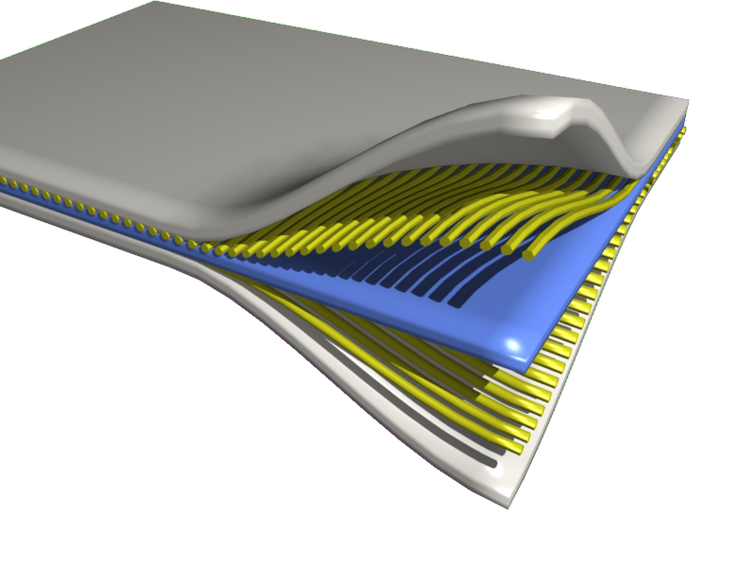
Composite materials
A composite material is made by combining two or more materials – often ones that have very different properties.
Picture 2: composites material

Slide 10
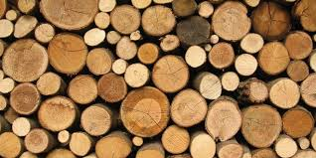
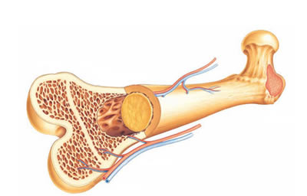
Naturals composites
Picture 4: bone
Picture 3: wood

Slide 11
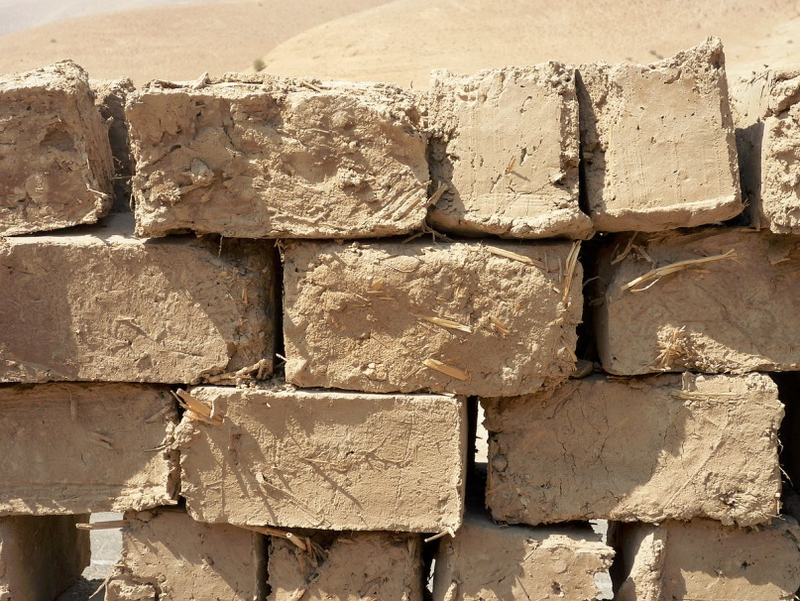
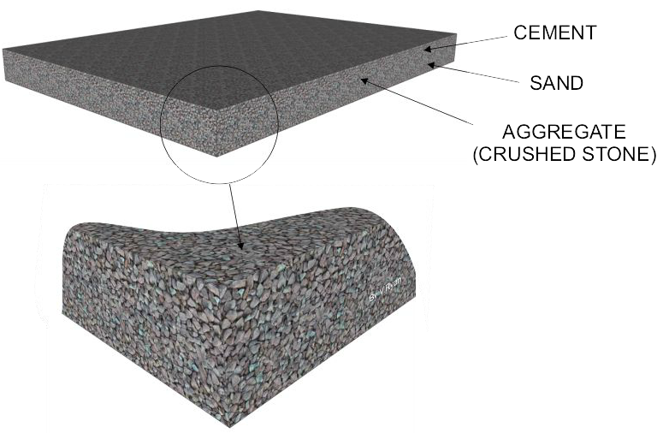
Early composites
Picture 6: mud bricks
Picture 7: concrete

Slide 12
Picture 8: reinforced concrete

Slide 13
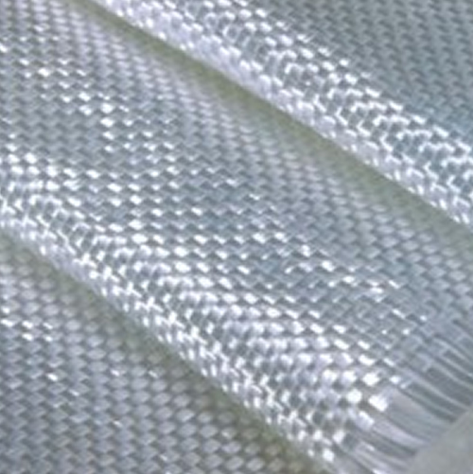
Modern examples
The first modern composite material was fibreglass.
Picture 9: fibreglass

Slide 14
Picture 10: carbon fibres

Slide 15
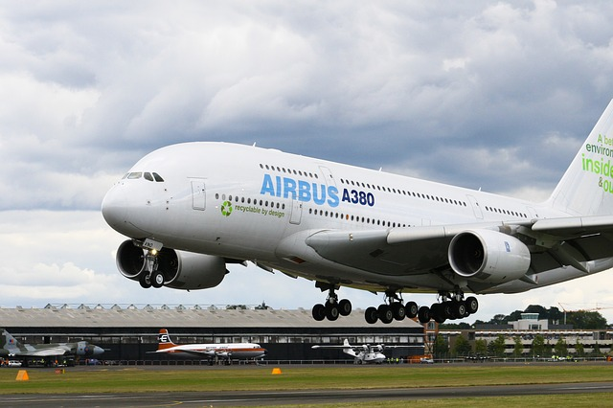
Picture 11: AIRBUS A380

Slide 16
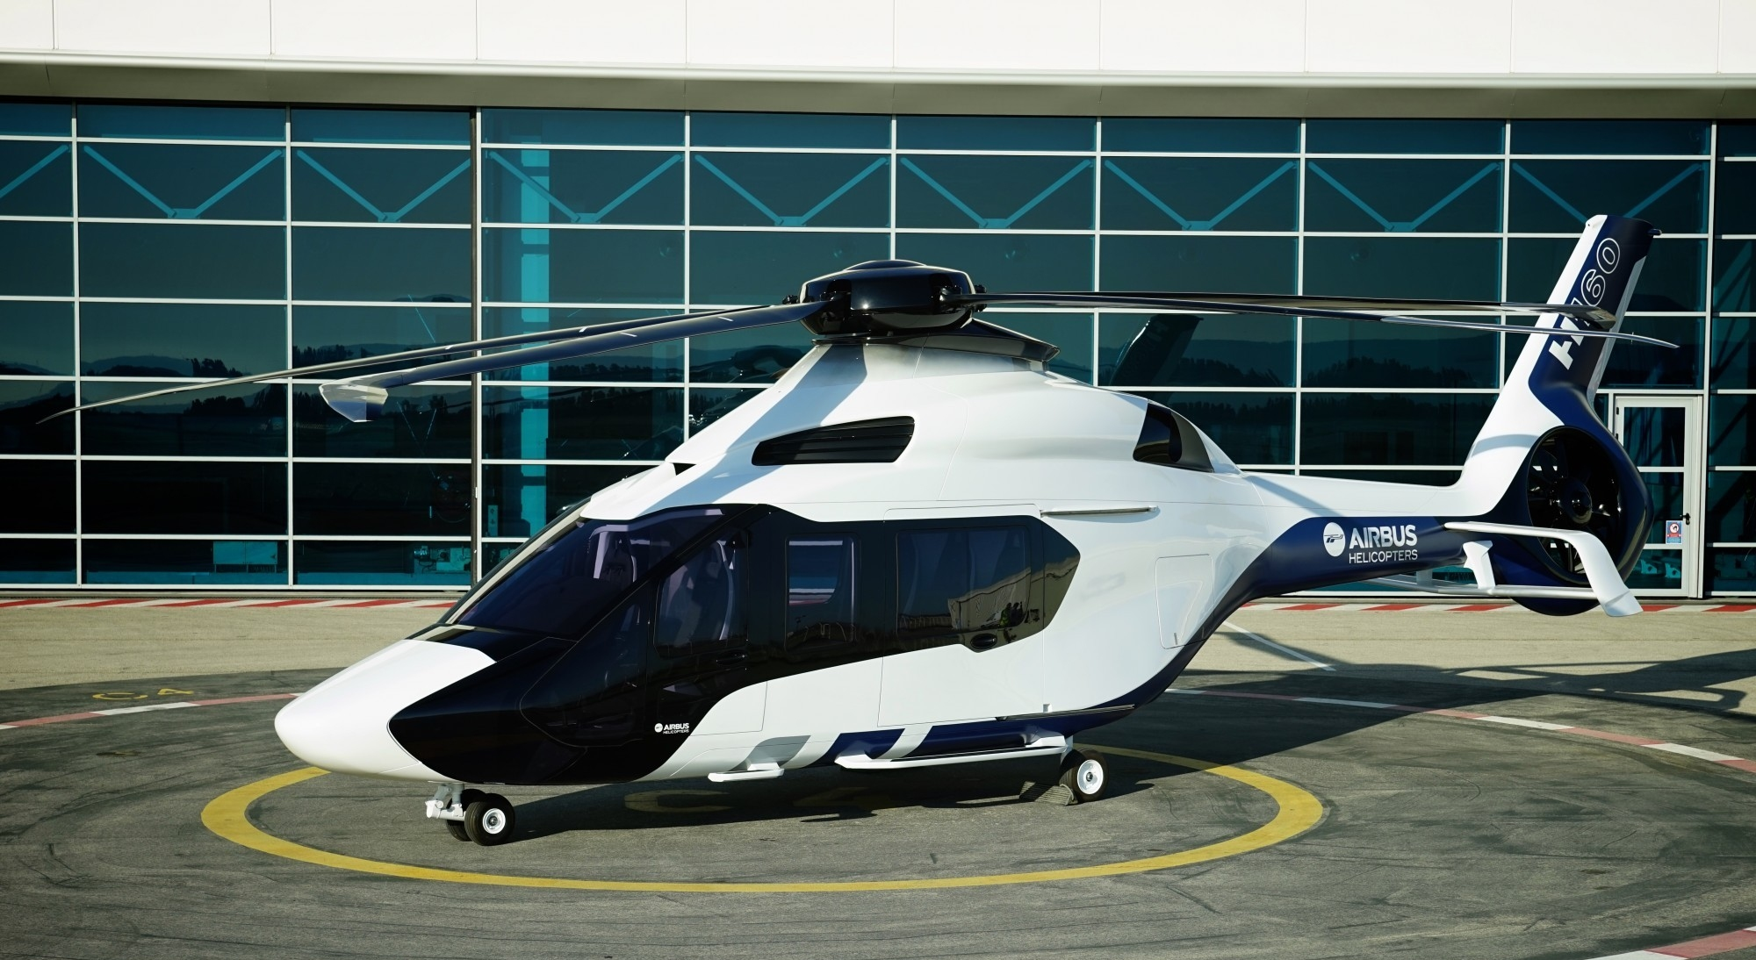
Picture 12: AIRBUS H160

Slide 17
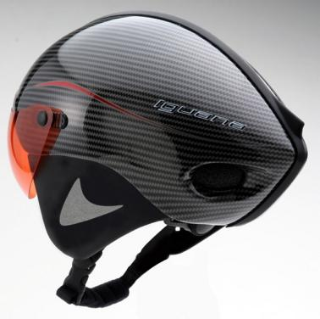
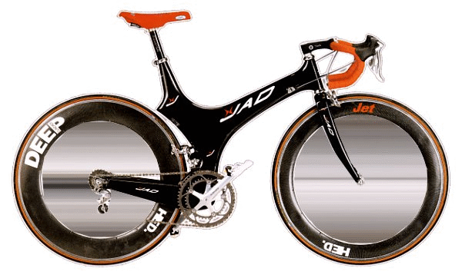
Picture 13: helmet
Picture 14: bicycle

